Slide 1
Compact Programming Course - Java
CAPSTONE PROJECT
Automated Cold Chain Logistics
& Storage System
Group – 9 :
Lavanya Eswarappa – MDT – 7224098
Keya Shah - MDT - 7224656
Nayana Nagaraj - MDT – 7223979 Tooba Arif - ESE - 7224112

Slide 2
Role Distribution
AGV Management System
Lavanya Eswarappa
Task Management and Scheduling System
Keya Shah
Automated Cold Chain Logistics
& Storage System
Environment and Storage System
Nayana Nagaraj
Log Management and Charging Station System
Tooba Arif

Slide 3
Description of the Domain
Problem
Modern warehouses must manage temperature-sensitive inventory across multiple zones and coordinate limited AGVs efficiently.
Key Challenges
Temperature zones: –20°C, 20°C, 30°C.
Only 3 AGVs with battery constraints.
Priority-based task handling.
Safe concurrent operations.
Our Solution
An intelligent AGV-driven warehouse system with: - Item sorting by zone and temperature. - Real-time battery monitoring & auto-charging. - Priority task queue. - Thread-safe concurrency. - Centralized logging.

Slide 4
Requirements to the system:
AGV Management
- Manage 3 AGVs with real-time battery monitoring
- Auto-charging below 20%
- Battery-based movement simulation
Task Management
Priority queue (1–10)
- Auto task assignment
- Transport + charging tasks
- Background scheduler
Storage Management
6 temperature zones + 1 unsorted area
- Capacity checks
- Thread-safe item handling
Logging System
- AGV, Task, and Environment logs
- Daily log rotation

Slide 5
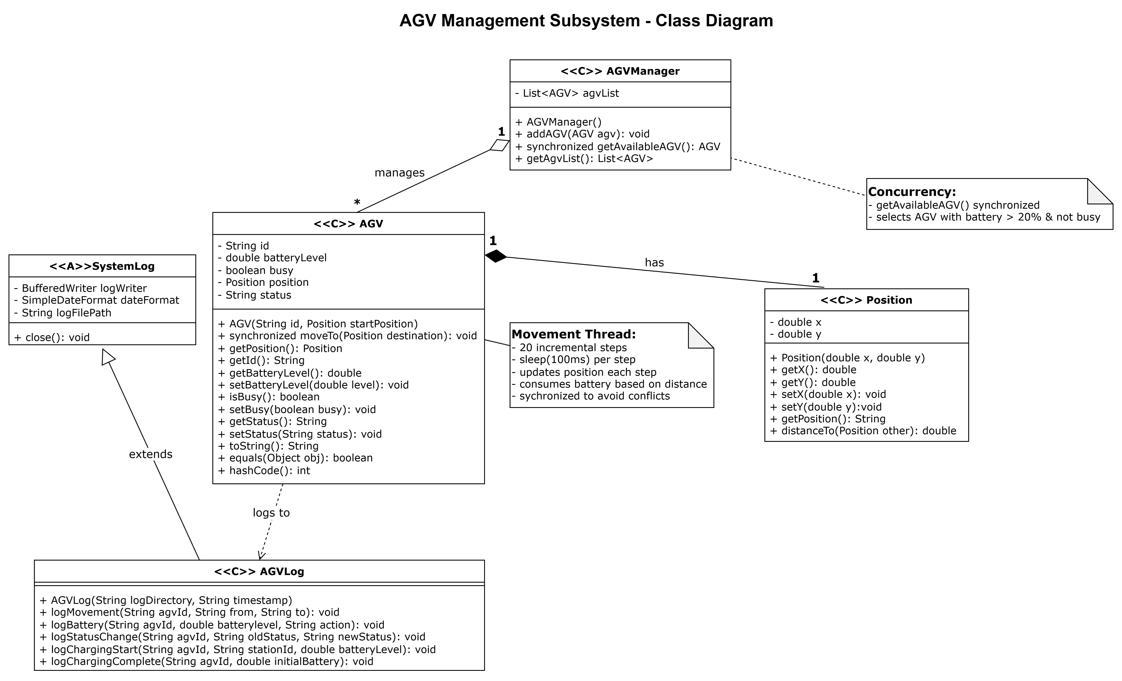
UML and Component Diagram

Slide 6
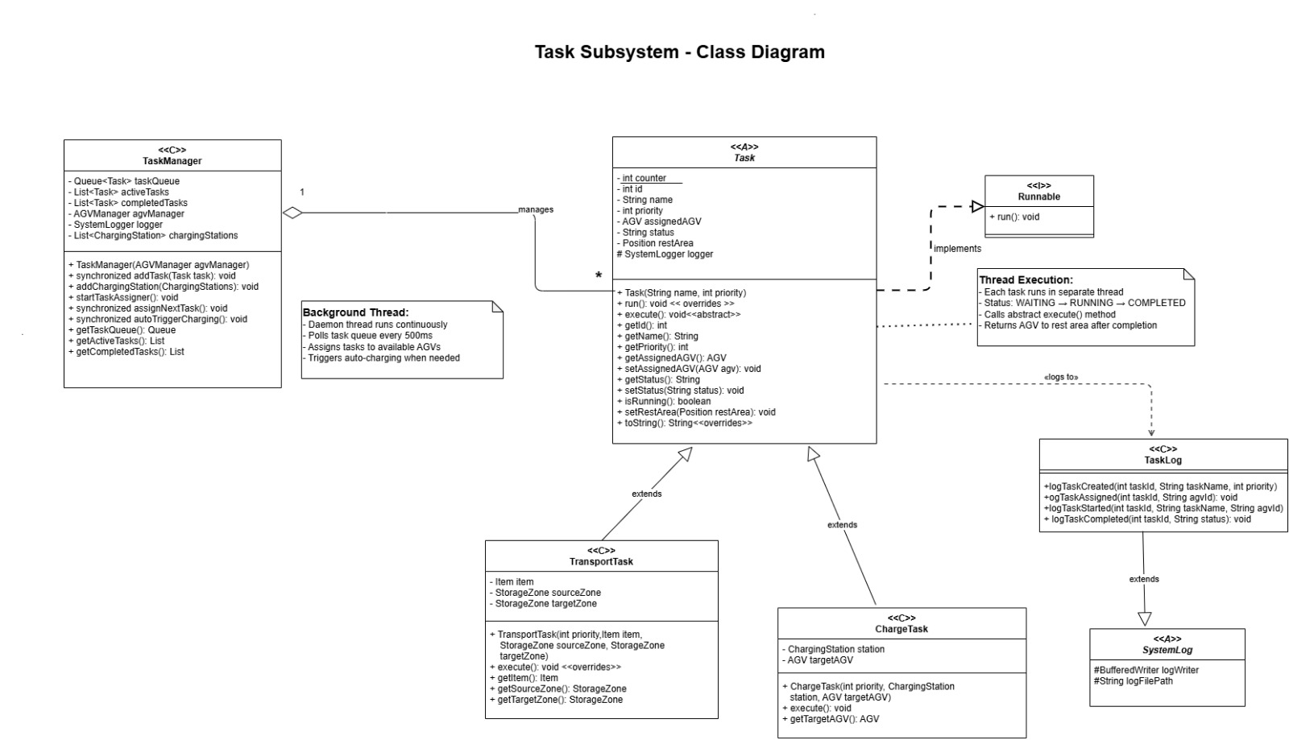

Slide 7
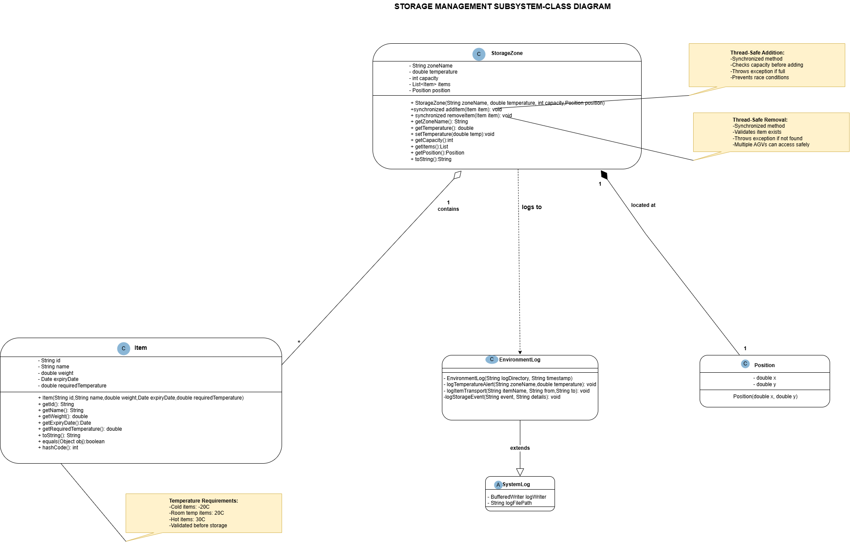

Slide 8
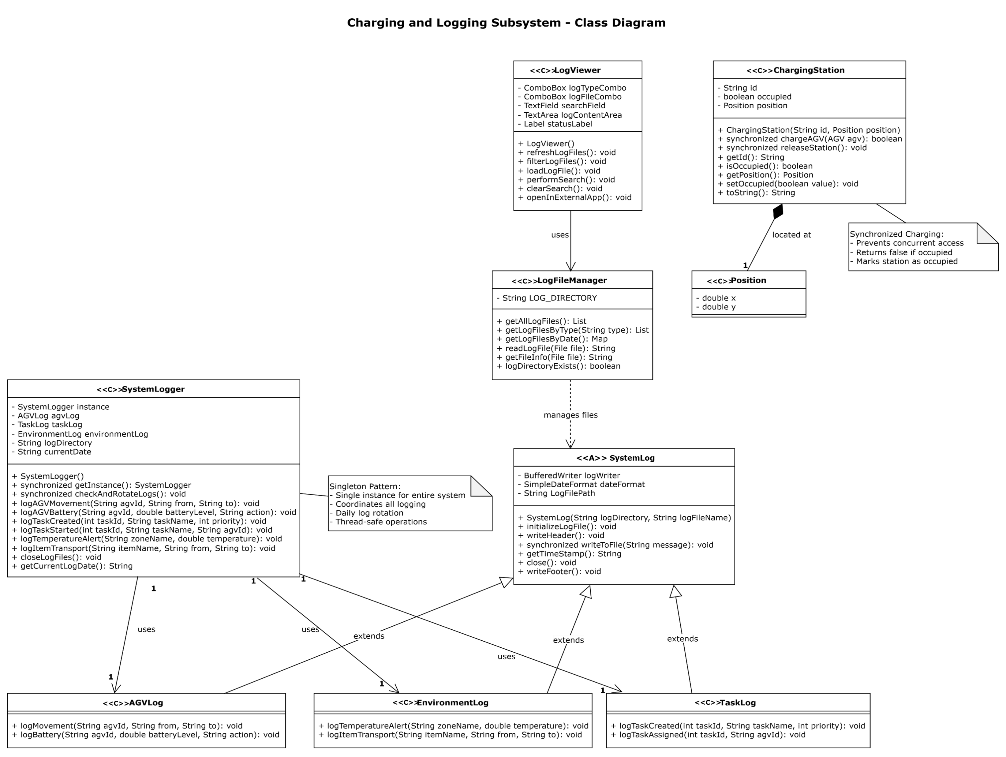

Slide 9
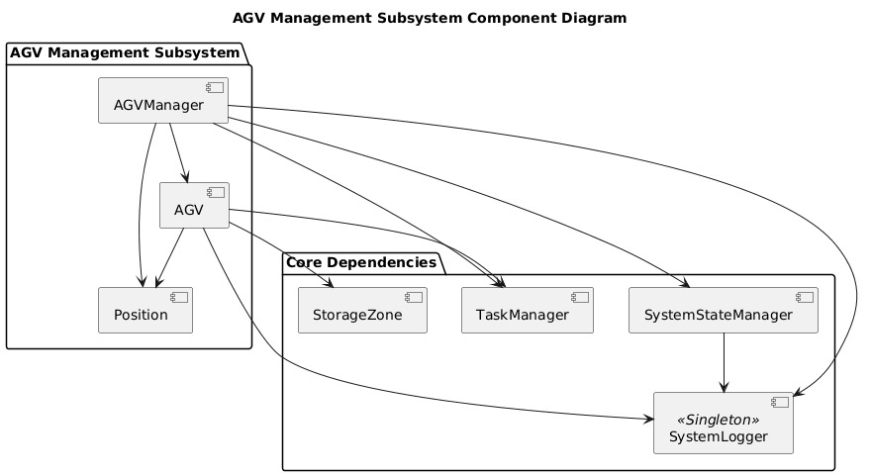
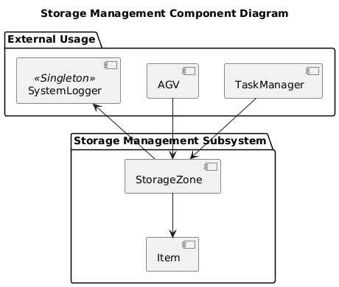
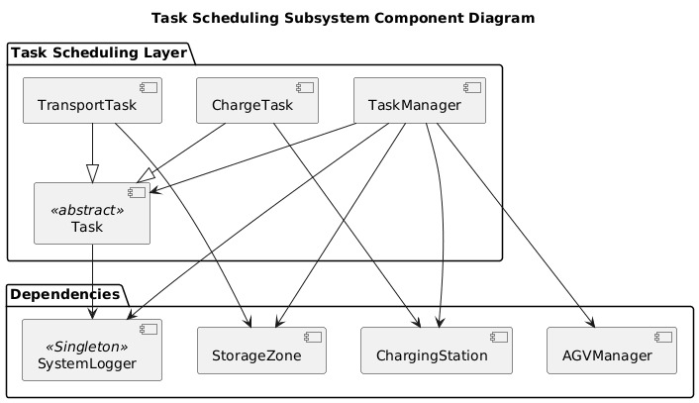

Slide 10
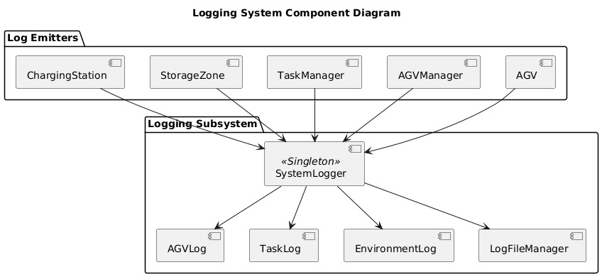
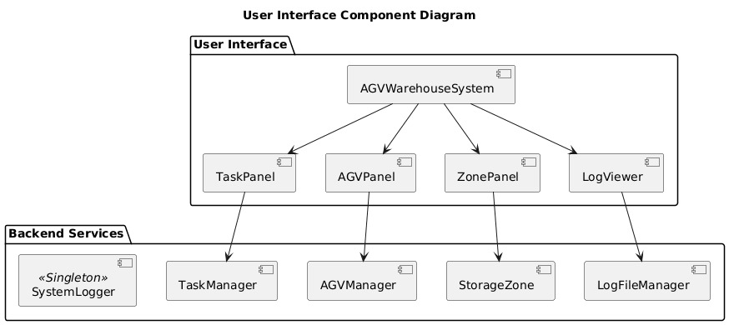
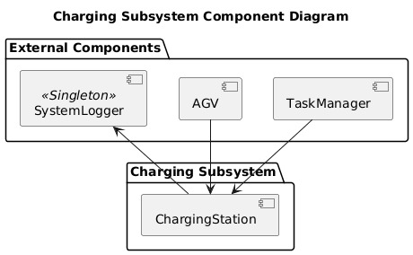

Slide 11
Management I/O in the system:
INPUT
User Inputs
Create tasks (priority, zones, items)
Trigger auto-sorting
Search & open log files
System Inputs
AGV battery & position updates
Task completion events
Storage zone capacity checks
OUTPUT
File Output
Timestamped AGV, Task & Environment log files
Efficient writing with BufferedWriter (append mode)
Console Output
Task assignment, AGV movement, charging alerts
UI Output
Real-time warehouse simulation (200 ms refresh)
AGV status + task queue updates
Log viewer displaying selected logs

Slide 12
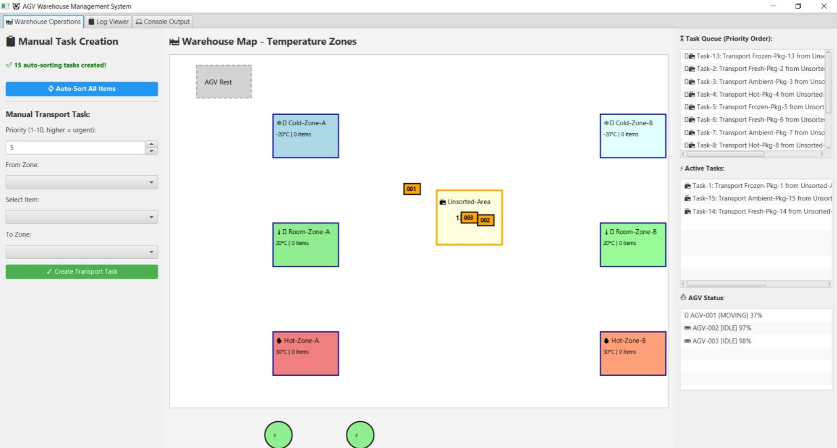
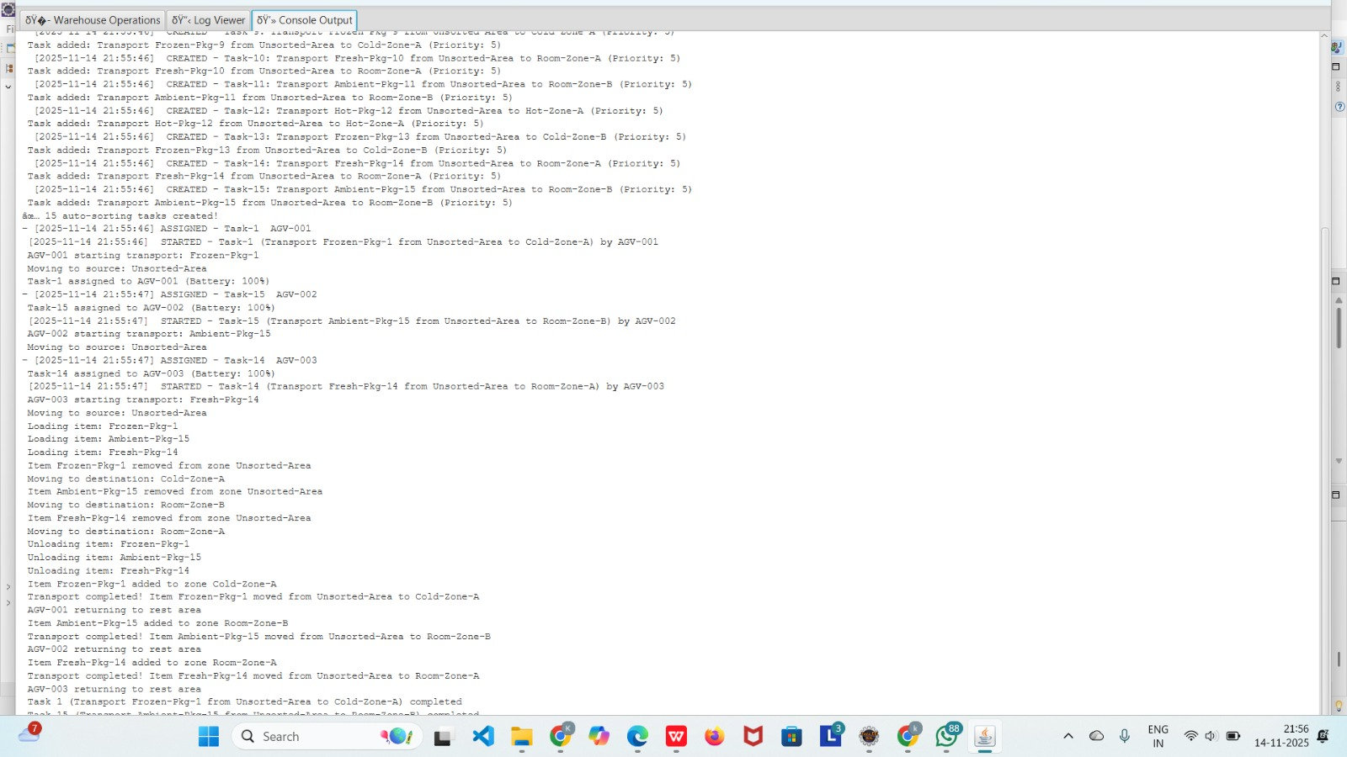
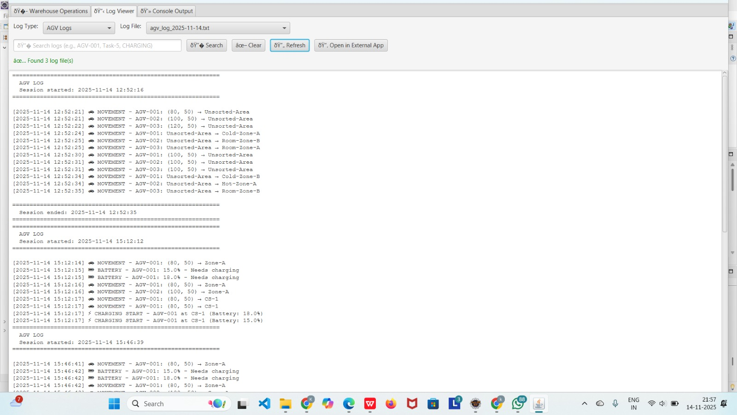
User Interfaces and Log Viewer:

Slide 13
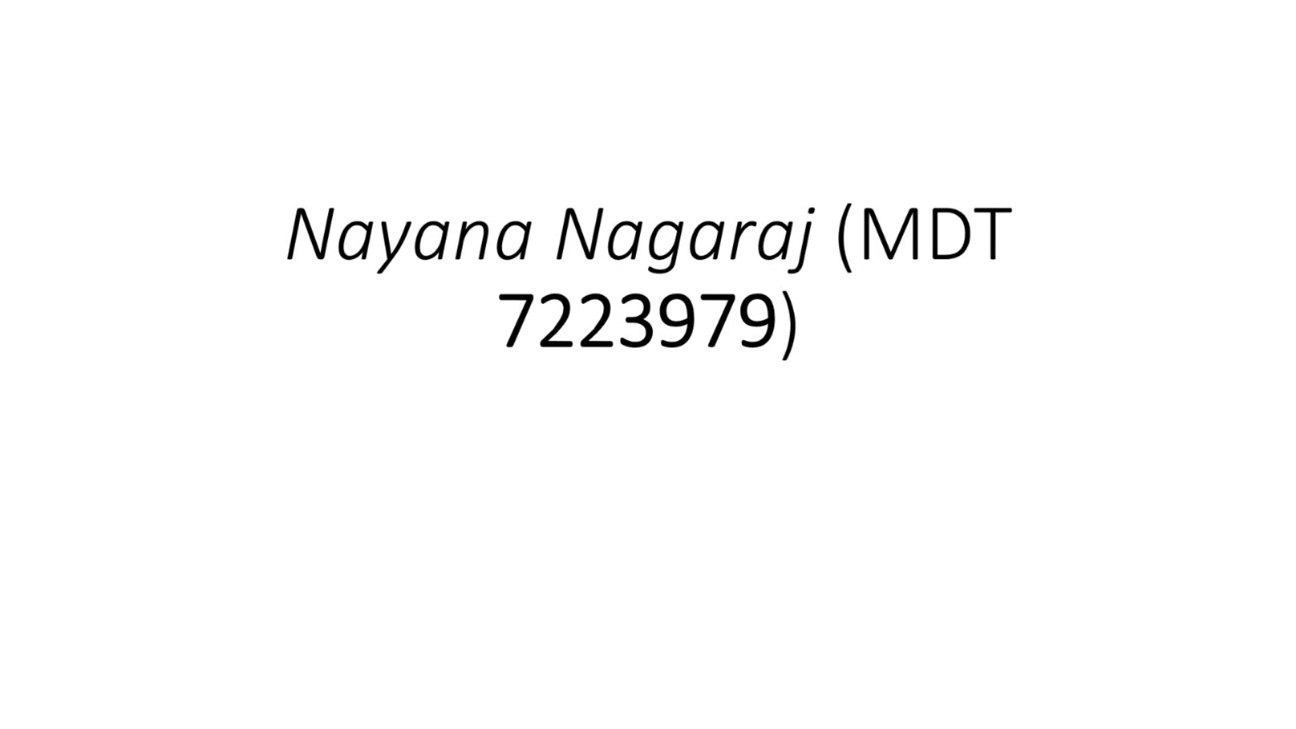
User Interfaces and Log Viewer:

Slide 14

Code Walkthrough:

Slide 15
Access to Project and Video Explanation
Link to GitHub Repository Explanation:
GitHub - Java Capstone Project
Video Link to User Interface Explanation
User Interface Explanation Video
Video Link to Code Explanation
Code Explanation Video

Slide 16
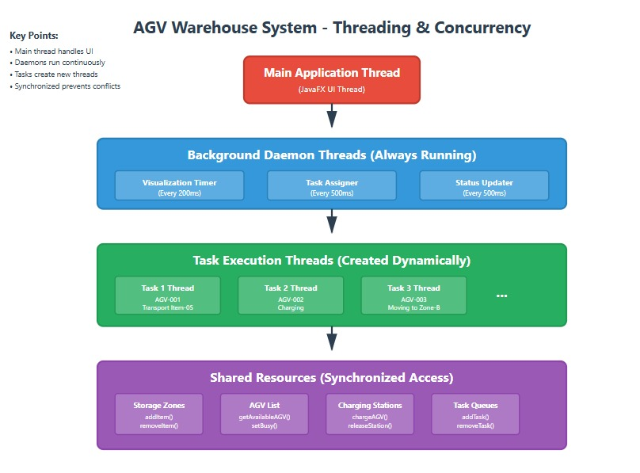
Description of the concurrency/threads implementation for each subsystem

Slide 17
AGV Control
Synchronized moveTo() ensures safe movement & battery updates
AGV allocation is synchronized → avoids double-booking
All 3 AGVs run independently without conflicts
Task Management
Background scheduler (500 ms) assigns tasks & auto-charging
Each task runs in its own thread
Thread-safe priority queue
synchronized methods prevent double AGV assignment
Storage & Charging
StorageZone addItem() / removeItem() synchronized → no overflow or lost items
Charging station allows only 1 AGV at a time
Prevents race conditions between multiple AGVs
UI Updates (JavaFX)
UI refreshed every 200 ms using Platform.runLater()
Background threads → UI thread safely
Smooth animations & live status updates
Console redirected to UI in a thread-safe manner

Slide 18
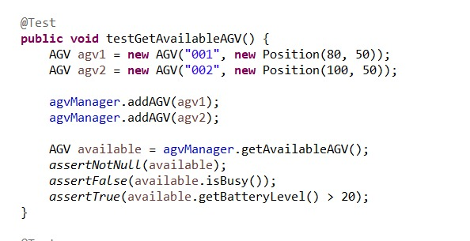
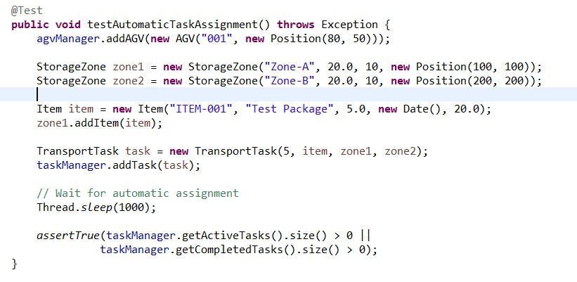
Unit Test of the System:

Slide 19
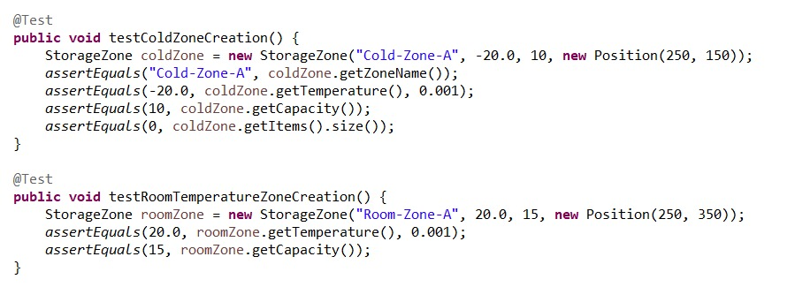
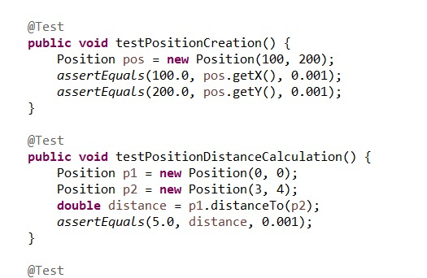

Slide 20
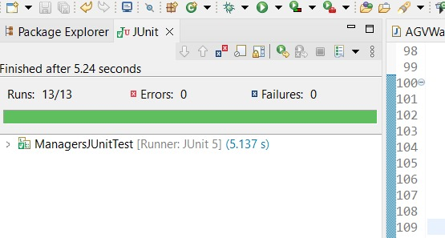
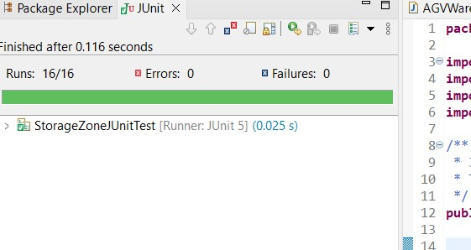
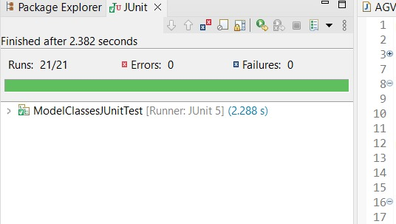
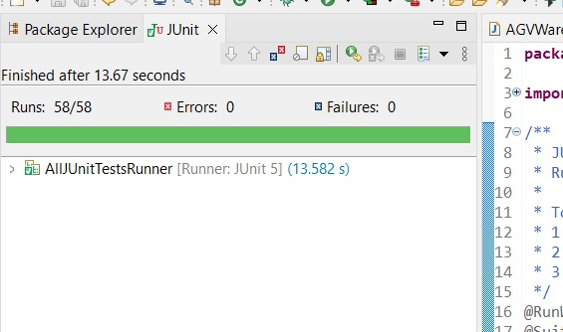
Results of Unit Test of the System:

Slide 21
THANK YOU!!

